Slide 1
Data Analysis
An Exploratory Data Analysis and Hypothesis Testing

Slide 2
Contents
1. Introduction to the Dataset
2. Research Question / Hypothesis
3. Exploratory Data Analysis (EDA) Overview
4. EDA - Data Cleaning and Preprocessing
5. EDA - Descriptive Statistics
6. EDA - Correlation Analysis
7. EDA - Key Visualizations
8. Hypothesis Testing
9. What Was Missed in Analysis
10. Challenges and Assumptions
11. Conclusion and Future Work
12. Questions
13. References

Slide 3
Introduction to the Dataset
Dataset Overview:
• The UCI Heart Disease dataset contains medical information of patients with 14 attributes.
• The goal is to predict the presence or absence of heart disease in a patient.
• Source: Kaggle
Notes:
Consider talking about:
Data requirements
Data collection
Data processing
Data cleaning
Exploratory data analysis
Modeling and algorithms
Data product
Communication

Slide 4
Research Question / Hypothesis
• Primary Question:
• Can we accurately predict the presence of heart disease based on the patient’s medical attributes using this dataset?
• Hypothesis:
• Certain medical features, such as age, cholesterol levels, and maximum heart rate, are significant predictors of heart disease.
Notes:
Consider talking about:
Data requirements
Data collection
Data processing
Data cleaning
Exploratory data analysis
Modeling and algorithms
Data product
Communication

Slide 5
Exploratory Data Analysis (EDA) Overview
Key Steps in EDA:
• Data Cleaning (handling missing values, outliers)
• Descriptive Statistics (mean, median, mode)
• Correlation Analysis
• Visualization Techniques (histograms, scatter plots, heatmaps)
To identify patterns, relationships, and insights that inform the modeling process.

Slide 6
EDA - Data Cleaning and Preprocessing
• Data Cleaning:
• Handled missing values using imputation techniques.
• Removed or treated outliers.
• Preprocessing:
• Standardization or normalization of continuous variables.
• Encoding categorical variables (e.g., sex, chest pain type).

Slide 7
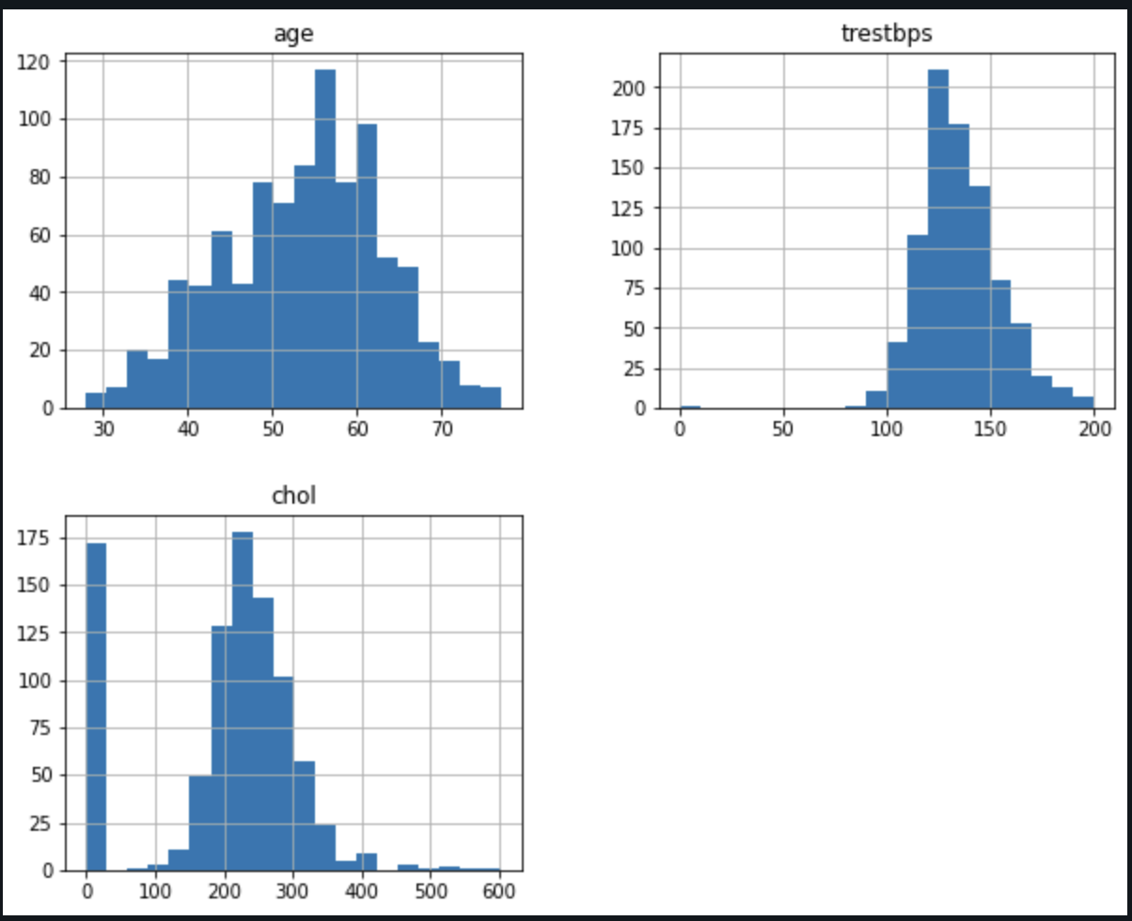
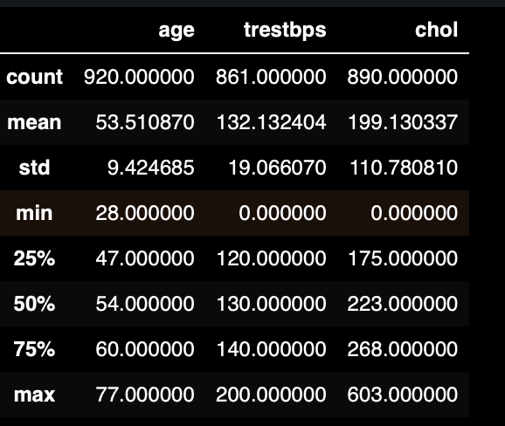
Descriptive Statistics
Key Descriptive Insights:
• Distribution of age, sex, and key medical metrics like cholesterol.
• Summary statistics for numerical features.
• Visual Aids:

Slide 8
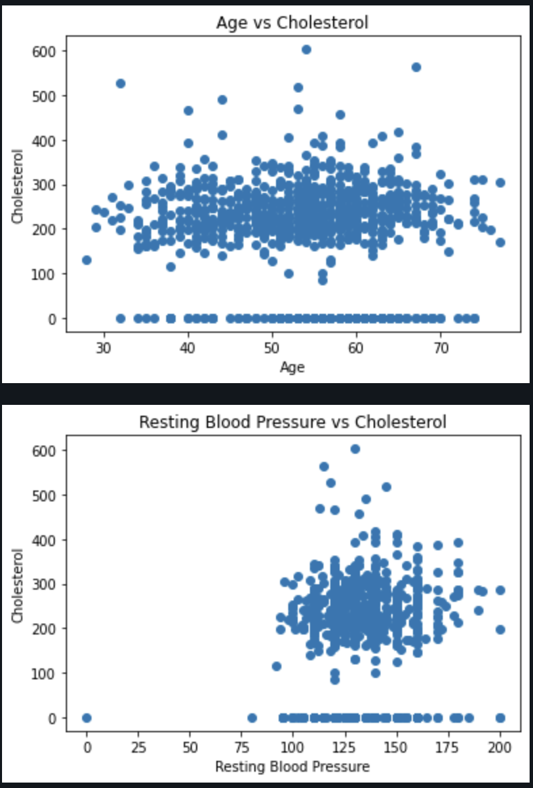
Correlation Analysis
• Correlation Matrix:
• Show heatmap or correlation table of variables.
• Highlight variables with strong positive/negative correlation with the target variable (presence of heart disease).
• Insights:
Notes:
Consider talking about:
Confusing fact and opinion
Cognitive biases
Innumeracy

Slide 9
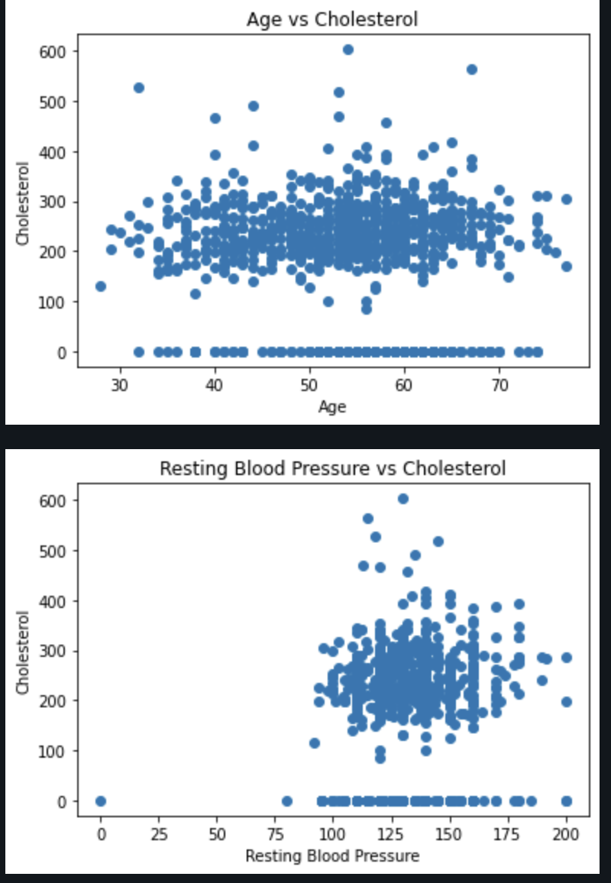
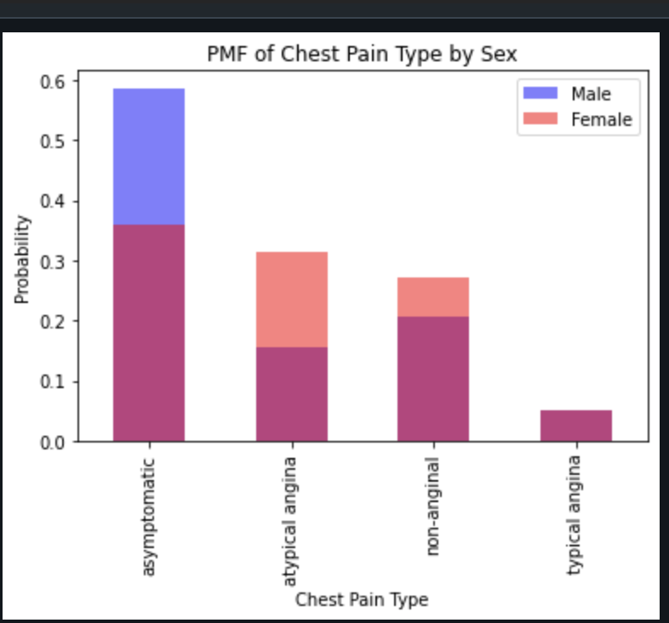
Key Visualizations
• Histogram of age distribution among heart disease patients.
• Scatter plot of cholesterol vs. maximum heart rate.
Notes:
Consider talking about:
Smart buildings
Analytics and business intelligence
Education

Slide 10
Hypothesis Testing
• Formulation of Hypothesis:
• Null Hypothesis (H0): There is no significant relationship between the selected medical features and heart disease.
• Alternative Hypothesis (H1): There is a significant relationship between the selected medical features and heart disease.
• Statistical Tests Used:
• T-test,
• Results:
• Discuss p-values and whether you reject or fail to reject the null hypothesis.
Interpretation of Results:
• Statistical Significance:
• The p-value is much lower than the commonly used threshold of 0.05, indicating strong evidence against the null hypothesis. This means that the difference observed in your sample data is highly unlikely to have occurred by chance.
• Conclusion:
• Given this T-statistic and p-value, you would reject the null hypothesis. In the context of your analysis, this could mean that the variable you tested (which the T-statistic pertains to) has a statistically significant effect on the outcome variable, such as the presence or absence of heart disease.
This result suggests a meaningful relationship between the tested variable and the outcome, warranting further investigation or consideration in any predictive models you may develop.
Notes:
Consider talking about:
Initial data analysis
Main data analysis

Slide 11
What Was Missed in Analysis
• Missed Opportunities:
• Lack of interaction terms between variables.
• Potential non-linear relationships not explored.
• Data Limitation:
• Any unconsidered variables that could have been impactful.

Slide 12
Challenges and Assumptions
• Challenges:
• Balancing complexity with interpretability.
• Managing high correlation among features (multicollinearity).
• Assumptions:
• Assumed linearity and normality in certain variables.

Slide 13
Conclusion and Future Work
• Summary:
• The EDA provided a comprehensive understanding of the dataset and confirmed some medical predictors of heart disease.
• Next Steps:
• Model development and validation.
• Potential inclusion of additional data sources.
• Addressing missed analysis aspects.

Slide 14
Statistical/Hypothetical Question
The primary statistical question for this analysis was: “Is there a significant relationship between certain risk factors (e.g., age, cholesterol levels, blood pressure) and the likelihood of heart disease in the Heart Disease UCI dataset?” The hypothesis tested was that these variables have a significant effect on the presence of heart disease.
Outcome of Your Exploratory Data Analysis (EDA)
The EDA revealed several key insights:
• Correlation Analysis: Variables such as age, cholesterol levels, and maximum heart rate showed moderate correlations with the presence of heart disease.
• Distribution Analysis: Age and cholesterol levels had a relatively normal distribution, while other factors like resting blood pressure showed some skewness.
• Outliers: The data contained a few outliers, particularly in cholesterol and blood pressure readings, which were considered during analysis but not removed.
• Significance Testing: Variables like cholesterol and maximum heart rate had p-values well below the threshold of 0.05, indicating a significant relationship with heart disease.
What Do You Feel Was Missed During the Analysis?
One of the potential gaps in the analysis was the limited exploration of interaction effects between variables. While individual variables were examined, the combined effect of variables such as age and cholesterol levels on heart disease was not fully explored. Additionally, categorical variables, such as the type of chest pain, could have been analyzed more rigorously to determine their impact on the outcome.
Were There Any Variables You Felt Could Have Helped in the Analysis?
Including more lifestyle-related variables, such as smoking status, diet, and physical activity levels, could have provided a more comprehensive view of the factors contributing to heart disease. These variables, if available, would likely enhance the predictive power of the model and offer better insights into risk factors.
Were There Any Assumptions Made You Felt Were Incorrect?
One assumption made during the analysis was treating certain variables as linear when their relationship with heart disease might be more complex. For example, the relationship between cholesterol levels and heart disease might not be strictly linear, and assuming linearity could have led to oversimplification. Additionally, the assumption of normality in some variables might not hold true, affecting the reliability of certain statistical tests.
What Challenges Did You Face, What Did You Not Fully Understand?
The main challenge was dealing with the multicollinearity between some variables, which made it difficult to isolate the effect of each variable on the outcome. Another challenge was understanding the nuances of categorical variables and how to effectively incorporate them into the analysis. There was also some difficulty in interpreting the interaction effects between variables, which required a deeper understanding of advanced statistical techniques.
Overall, the analysis provided valuable insights into the risk factors for heart disease, but there is room for further exploration and refinement, particularly in understanding the complex relationships between multiple variables.

